Slide 1
While Loop

Slide 2
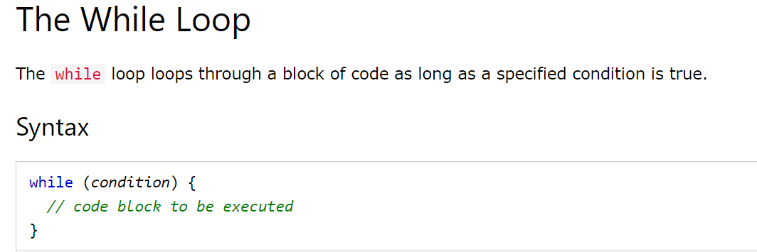
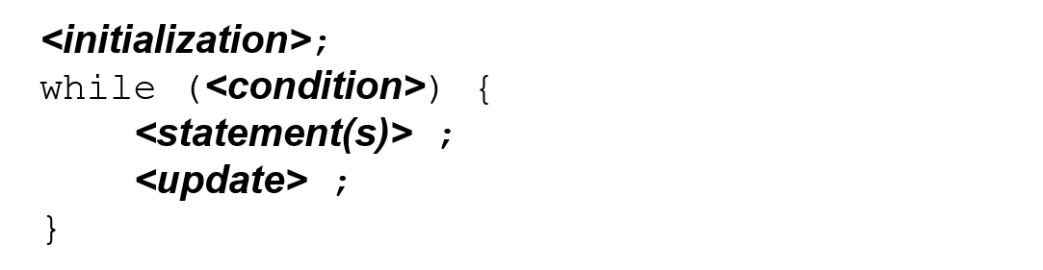

Slide 3
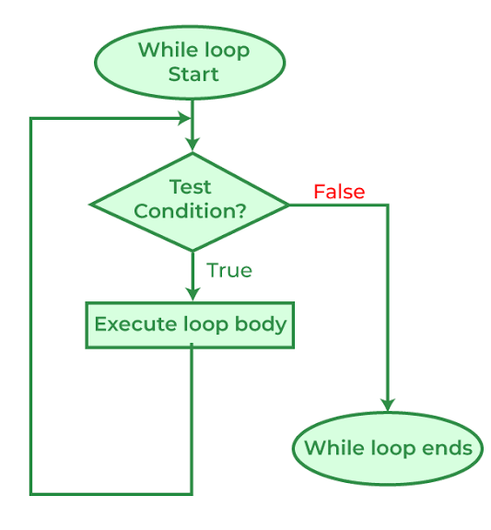
FLOW CHART

Slide 4
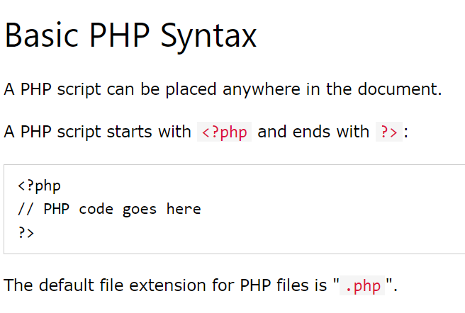

Codes
Note: In declaring PHP variables, it must be start with a $ sign
followed by variable name. Ex. $number, $txt, $date, etc.

Slide 5
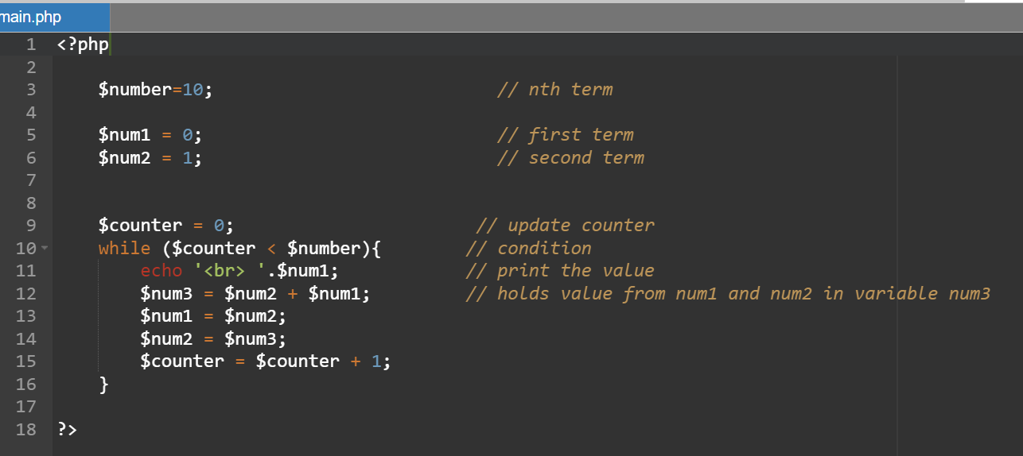
Fibonacci Sequence
Output:
Code:
0
1
1
2
3
5
8
13
21
34
Note: Save your file as “filename.php”

Slide 6
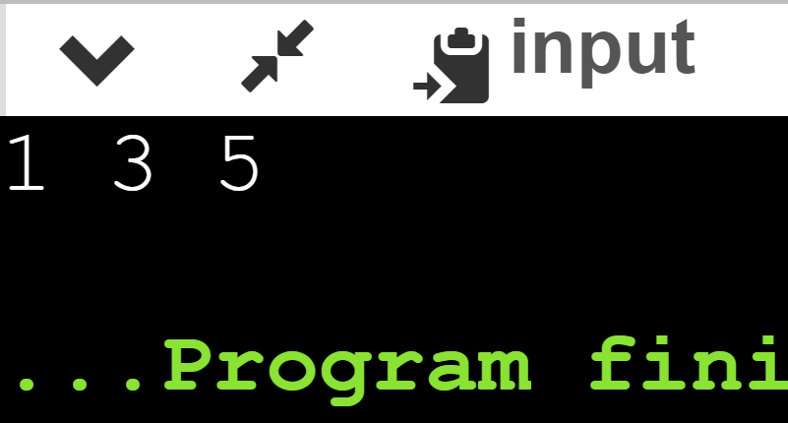
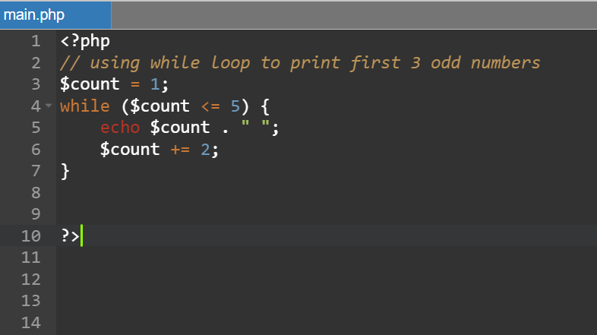
Code:
Output:

Slide 7

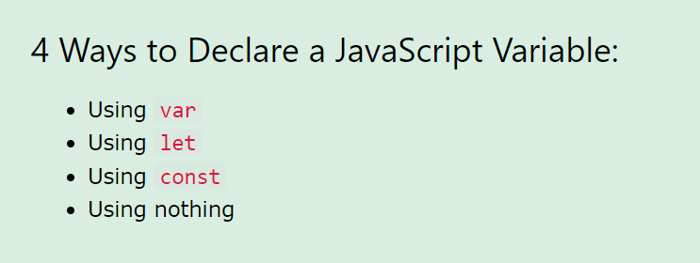

Slide 8
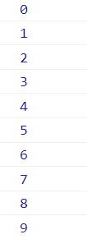
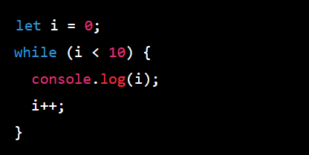
Output:
Code:
Notes:
This code will continuously print out the value of i as long as it is less than 10. The loop starts with i equal to 0, and increments i by 1 with each iteration of the loop until it reaches 10.

Slide 9
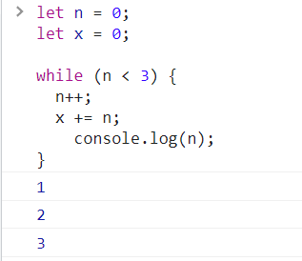
Code:
Output:

Slide 10
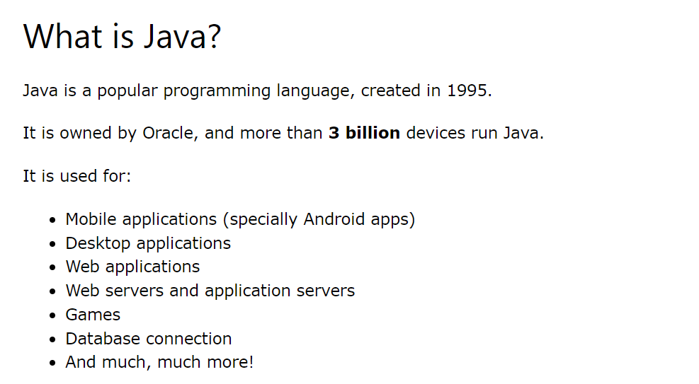


Slide 11
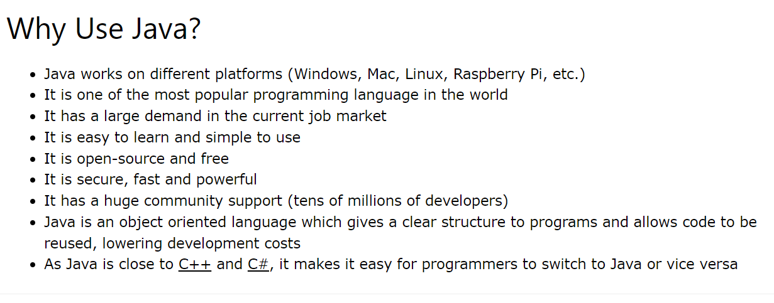

Slide 12
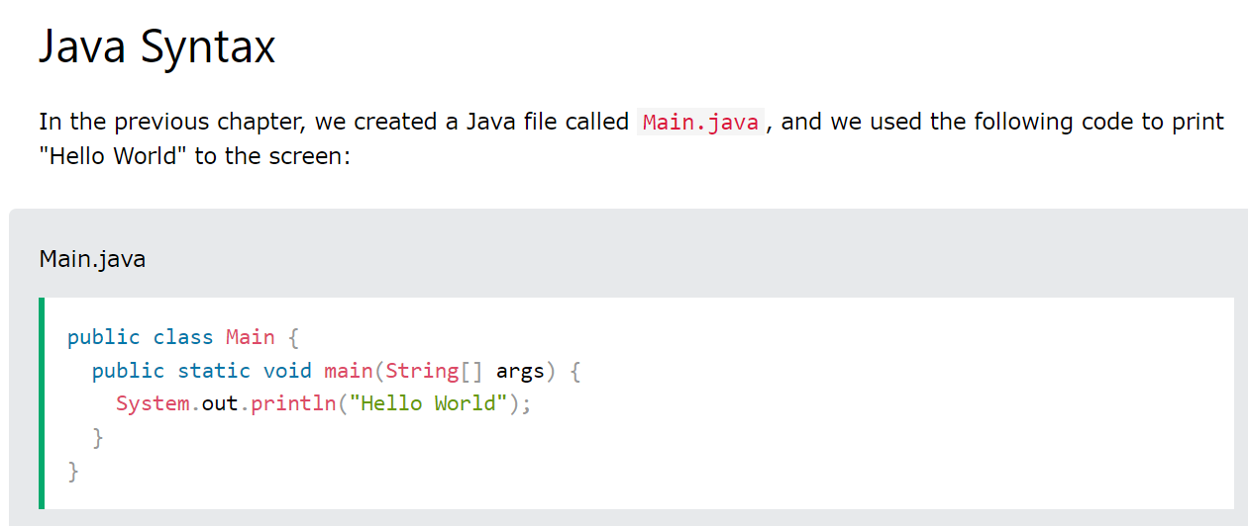

Slide 13
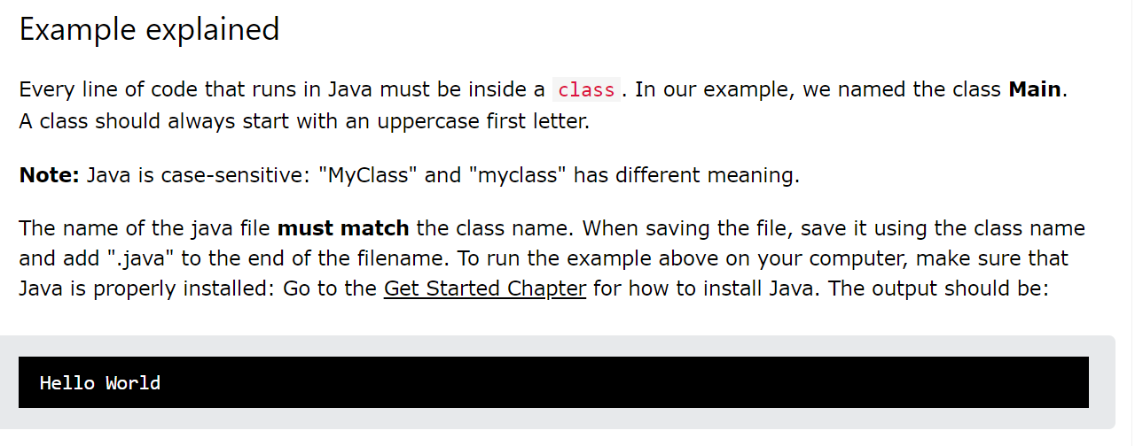

Slide 14
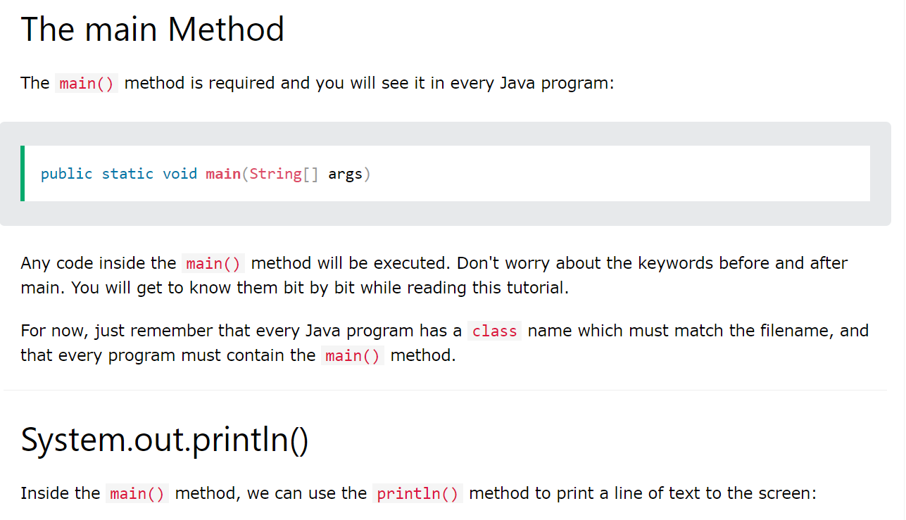

Slide 15
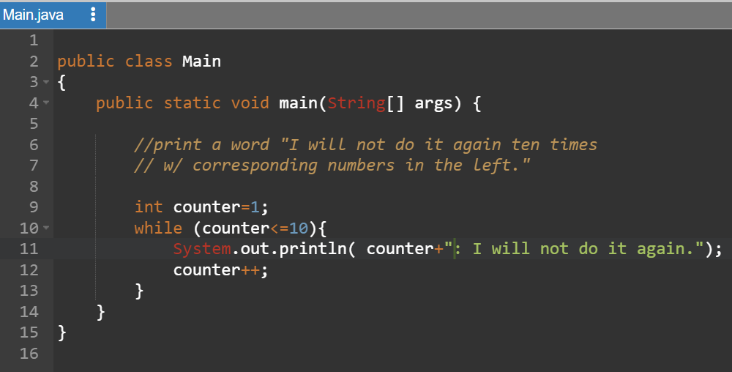
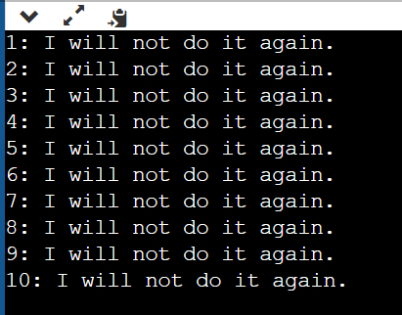
Code:
Output:

Slide 16
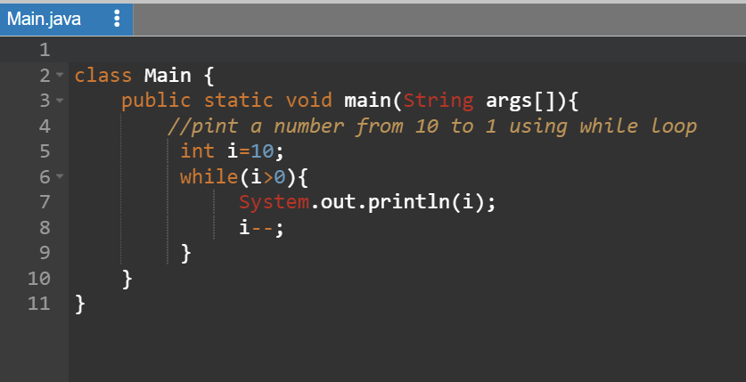
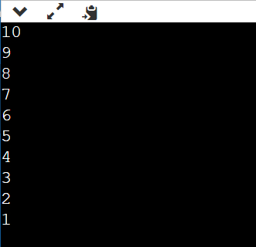
Code:
Output:

